Slide 1

A Paper Review By Naimur Islam Navid
Towards a Security Stress-Test for
Cloud Configurations

Slide 2
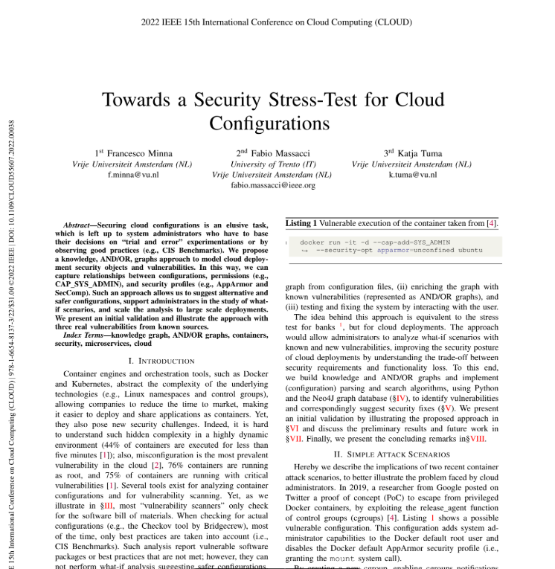
Introduction of the paper
Title: Towards a Security Stress-Test for Cloud Configurations
Authors: Francesco Minna, Fabio Massacci, Katja Tuma
Affiliation: Vrije Universiteit Amsterdam, University of Trento
Conference: IEEE 15th International Conference on Cloud Computing, 2022

Slide 3
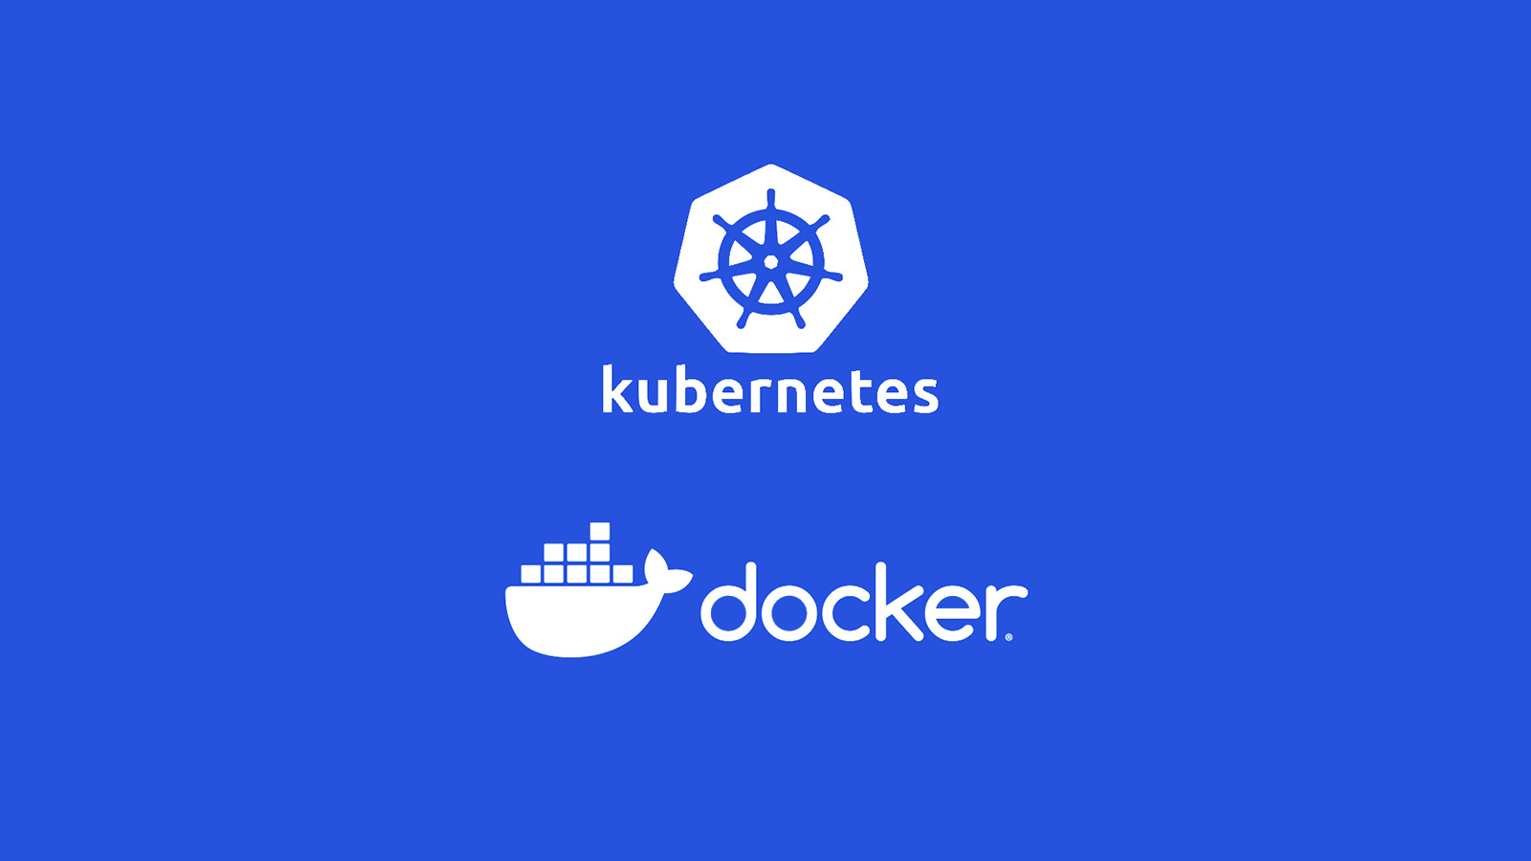
Tools like Docker and Kubernetes have revolutionized the way we manage applications. These container engines and orchestration platforms make it easier to deploy, scale, and manage applications efficiently across various environments.
Paper Review on cloud Security
Towards a Security Stress-Test for
Cloud Configurations
Cloud computing is very popular today because it’s flexible and easy to use. But keeping it secure can be tricky. Many system administrators use trial-and-error or follow basic rules to protect their cloud systems. Unfortunately, these methods are not enough to fully stop security problems.

Slide 4


Problem Statement
Security Challenges in Containerized Environments
Dynamic Nature:
44% of containers run for less than 5 minutes.
Misconfigurations:
The most common cloud vulnerability.
76% of containers run as root.
75% of containers have critical vulnerabilities.
Key Issue: Securing cloud configurations is a complex task due to dynamic environments and and reliance on trial-and-error method.
most “vulnerability scanners” only check for the software bill of materials.
When checking for actual configurations most of the time, only best practices are taken into account (i.e., CIS Benchmarks)
Proposed Solution
The authors propose a "stress-test" approach for cloud security, similar to how banks test their financial stability. This involves:
Knowledge-based AND/OR graphs for:
Modeling configurations and vulnerabilities.
Analyzing "what-if" scenarios for safer alternatives.
Testing and fixing the system by interacting with the user.
Goal: Suggest safer configurations and scale analysis to large deployments.

Slide 5

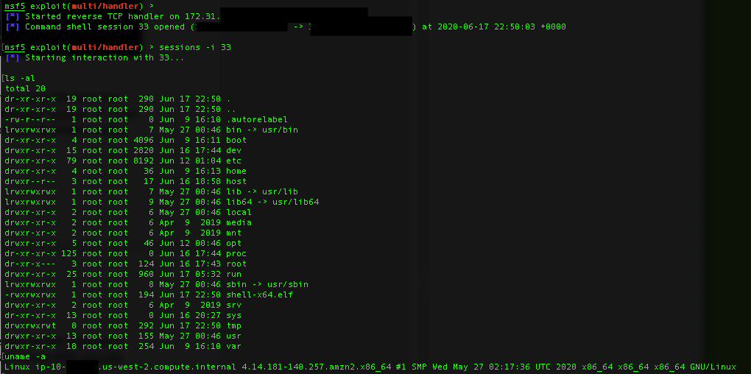

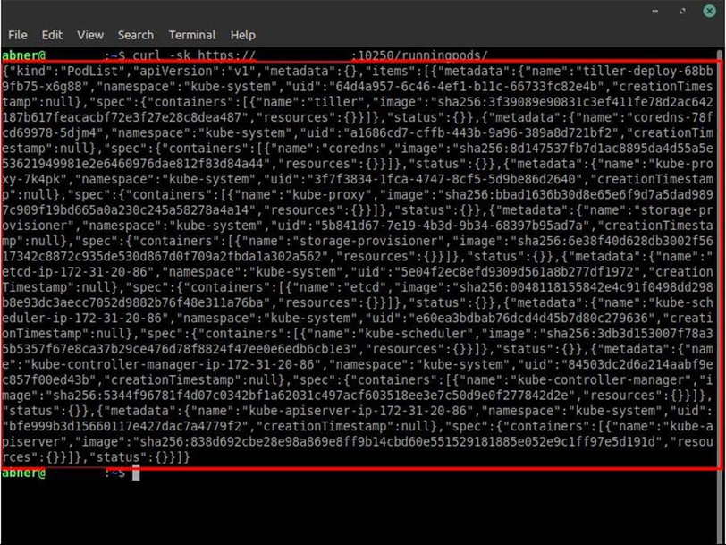
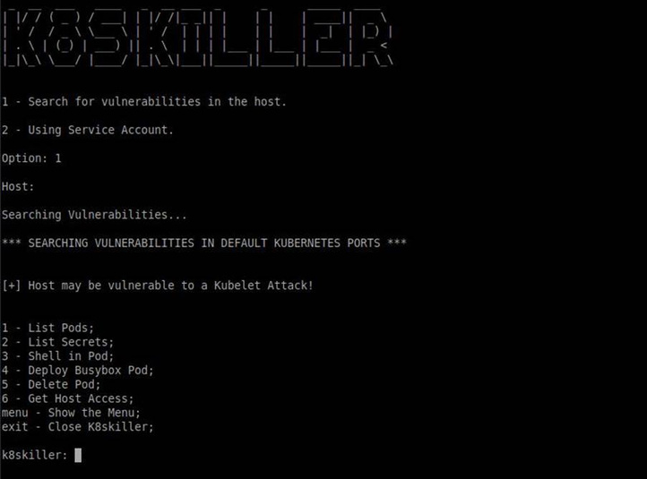
Attack Scenarios
Docker Attack (2019)
How it worked:
Used the release agent feature in cgroups to run code on the host system.
Why it happened:
Containers ran as root or privileged users.
Extra permissions like CAP_SYS_ADMIN were enabled.
Security profiles like AppArmor were disabled.
Fix:
Remove unnecessary permissions (e.g., --cap-drop ALL), but this can slow down containers.

Slide 6
Attack Scenarios
Linux Kernel Flaw (CVE-2022-0492)
How it worked:
Used a release agent issue to gain higher permissions on the system.
Why it happened:
Containers had root access or permissions like CAP_DAC_OVERRIDE.
Unsafe system calls like "mount" and "unshare" were allowed.

Slide 7
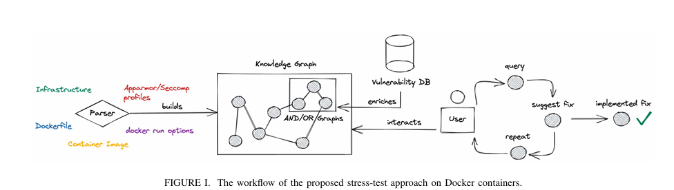
Workflow Overview
Step-by-Step Process:
Build the Knowledge Graph: Parse configuration files to map components.
Add Vulnerability Graphs: Link known vulnerabilities as AND/OR conditions.
3. Query and Fix:
Analyze configurations for weak points.
Suggest ranked fixes based on user preferences.
Outcome: Improved security through systematic analysis and guided fixes.

Slide 8

Related Work
Access control and network policies in cloud deployments are well-studied, but automated exploration and validation of practical configuration policies remain underexplored.
Ibrahim et al. [9] studied theoretical microservice attacks using vulnerabilities to build attack graphs, but their feasibility and practical configuration changes (e.g., dropping SYS_ADMIN capability) were not tested.
Security tools for cloud environments include configuration analyzers (e.g., Snyk, Docker Bench) that check settings against best practices and vulnerability scanners (e.g., Clair, Trivy) that compare container images with vulnerability databases.
Automatically suggesting fixes for cloud misconfigurations remains an open challenge, as existing tools rely on users to manually address vulnerabilities.
Knowledge graphs for cloud cybersecurity have been explored, primarily for security awareness and intelligence sharing, with some approaches like Banse et al.'s Cloud Property Graph focusing on linking static code analysis to runtime environments, but not on comprehensive configuration security analysis.
Operational Security
Social engineering by exploiting psychology and encouraging it to provide information and access to its tools

Slide 9
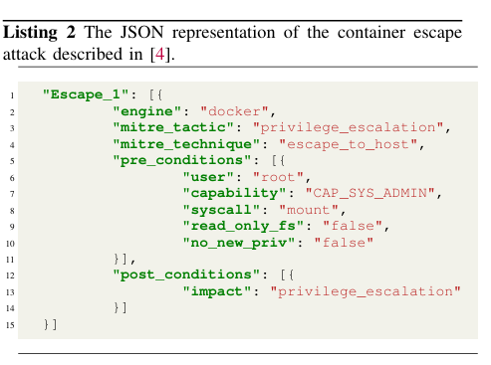
BUILDING THE GRAPHS
Build Knowledge Graphs:
Nodes represent configurations (e.g., permissions, Docker run options).
Edges map relationships (e.g., "Container has Capability").
Add AND/OR Vulnerability Graphs:
Model attack scenarios (e.g., "requires CAP_SYS_ADMIN").
Link vulnerabilities to configurations.

Slide 10
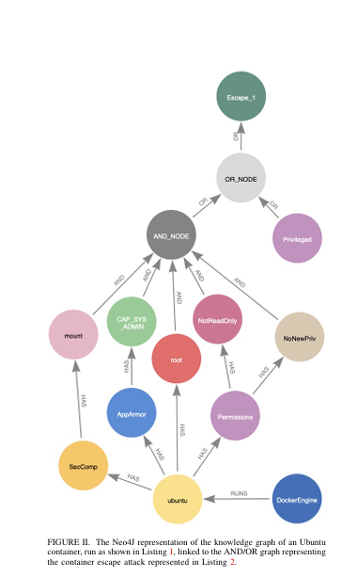
SUGGESTING A FIX
Process:
Query the graph to find vulnerabilities.
Recommend fixes ranked by user-defined preferences (e.g., least disruptive).
Analytic Hierarchy Process (AHP)
Examples of Fixes:
Avoid root privileges.
Drop unneeded capabilities.
Restrict system calls.
Set read-only file systems.
Outcome: Safer configurations with minimal impact on functionality.

Slide 11
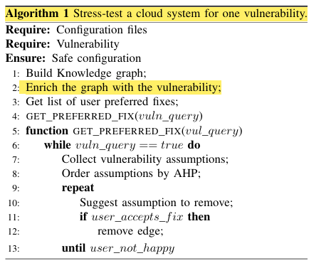
Suggesting Fix - Algorithm
Algorithm 1 shows the procedure to stress-test a cloud system by unveiling the presence of one vulnerability.
The steps of the algorithm are:
(1) parsing the configuration files and building the knowledge graph.
(2) adding and link the vulnerability AND/OR graph
(3) fetching user preferences, and finally
(4) suggesting the best fix
Cloud configurations often have multiple vulnerabilities, requiring a globally optimal solution that balances fixes. Our algorithm uses user-input weights (AHP) to prioritize preferences

Slide 12
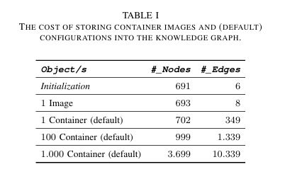
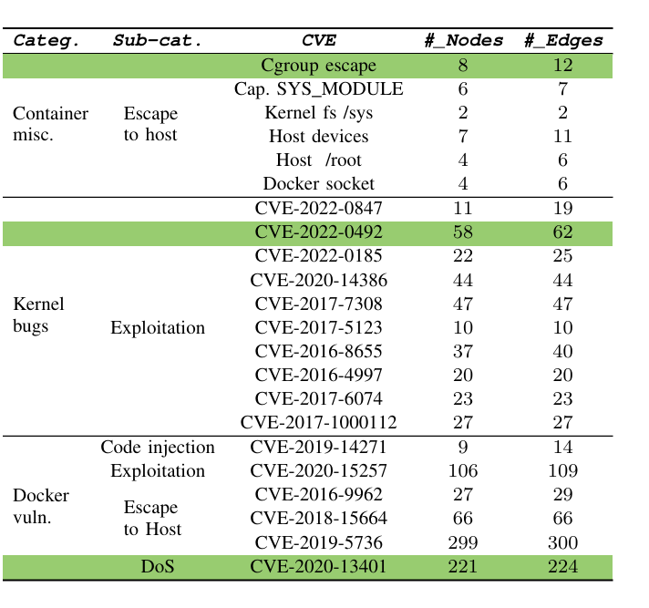
Preliminary Evaluation
Storage Efficiency:
Graph structure scales well with deployment size:
1,000 containers = ~3,700 nodes and 10,000 edges.
Use Case Tests:
Successfully analyzed vulnerabilities like CVE-2022-0492.
This research used one node to represent the host virtual machine, 50 nodes to represent the versions of Linux kernel. one node to represent the Docker engine, 132 nodes to represent the versions of Docker, 83 nodes to represent the versions of containerd, and 18 nodes to represent the versions of runc. In addition, it used 41 nodes to represent Linux capabilities and 364 nodes to represent Linux system calls. This amounts to 691 nodes and 6 relationships.

Slide 13

Preliminary Evaluation and in Future
The number of nodes and edges in the table corresponds to the AND/OR graph representing each vulnerability. To test the approach, they evaluated three vulnerabilities: Cgroup escape, CVE-2022-0492, and CVE-2020-13401. Currently, there's no existing algorithm to traverse the AND/OR graph in Neo4j, but they manually checked exploitability for initial validation. Future work involves implementing an algorithm to automatically check for vulnerabilities and testing the approach on all 36 vulnerabilities with various configurations (e.g., different AppArmor profiles and Docker run options).

Slide 14

Future Directions
Improvements Planned:
Automate the selection of optimal fixes.
Support for more tools (e.g., Kubernetes, Terraform).
Continuous monitoring of dynamic configurations.
Metrics for Resilience:
Track graph changes (e.g., removed edges) as a security score.

Slide 15
Conclusion and Acknowledgement
Conclusion
In this paper, they proposed a stress-test approach for cloud configurations, leveraging a knowledge graph to represent deployments and permissions, and using AND/OR graphs to represent vulnerabilities. Their solution includes algorithms that identify vulnerabilities and suggest semi-automated security fixes. They implemented and evaluated this approach on Docker containers, marking the first step toward a dynamic and continuous risk analysis mechanism for cloud environments. Future work will focus on validating scalability and query performance, especially in environments with large-scale deployments, and extending the approach to support more container engines, infrastructure-as-code tools, and orchestration platforms like Kubernetes.
Acknowledgments
Funding: Supported by the European Union under H2020 grant 952647 (AssureMOSS).
References: Key sources include Sysdig reports, MITRE ATT&CK, and Docker vulnerability analyses.

Slide 16
References
[1] Sysdig, “Sysdig 2022 cloud-native security and usage report,” (Accessed on: 28/03/2022). [Online]. Available: https://sysdig.com/2022-cloud native-security-and-usage-report/ 1 [
2] N. S. ities,” able: A. (Accessed (NSA), on: “Mitigating 09/03/2022). cloud [Online]. vulnerabil Avail https://media.defense.gov/2020/Jan/22/2002237484/-1/-1/0/CSI MITIGATING-CLOUD-VULNERABILITIES 20200121.PDF 1
[3] E. E. B. Authority), “Eba will run its next eu-wide stress test in 2023,” (Accessed on: 22/03/2022). [Online]. Available: https: //www.eba.europa.eu/eba-will-run-its-next-eu-wide-stress-test-2023
[4] T. of Bits, “Understanding docker container escapes,” (Accessed on: 23/03/2022). [Online]. Available: https://blog.trailofbits.com/2019/07/ 19/understanding-docker-container-escapes/ 1, 3
[5] P. A. U. 42, “New linux vulnerability cve-2022-0492 affecting cgroups: Can containers escape?” (Accessed on: 23/03/2022). [Online]. Available: https://unit42.paloaltonetworks.com/cve-2022-0492-cgroups/ 2
[6] X. Li, Y. Chen, and Z. Lin, “Towards automated inter-service authorization for microservice applications.” New York, NY, USA: Association for Computing Machinery, 2019, p. 3–5. 2

Slide 17
Thank you

